Slide 1
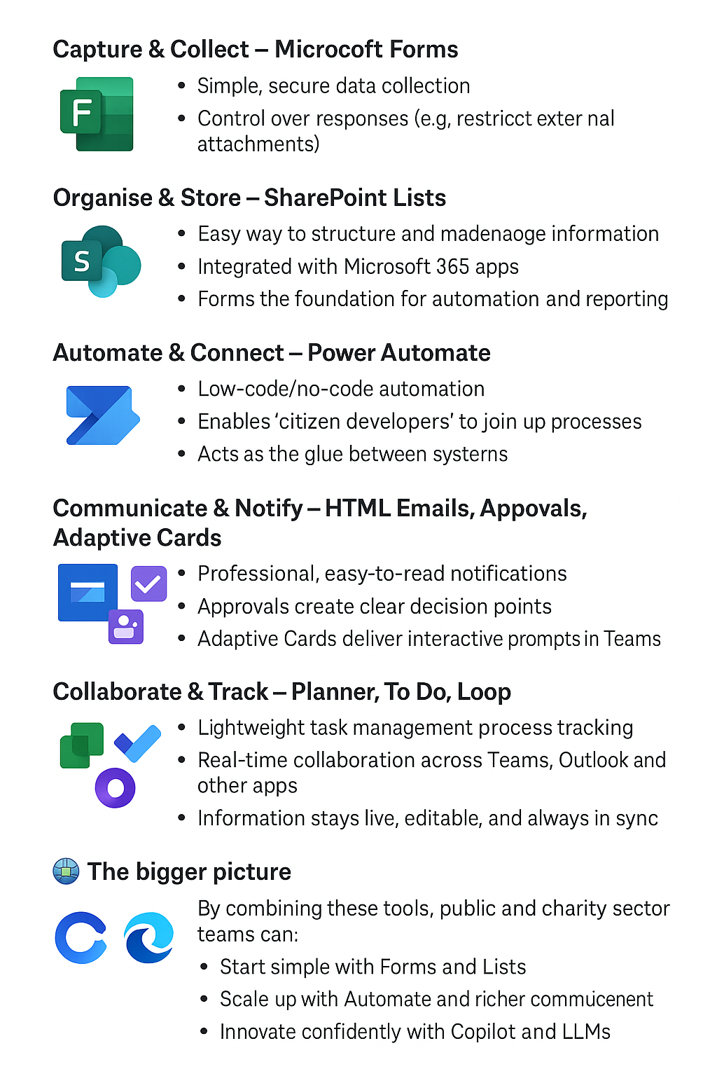
‘Citizen Developers’ toolkit
Github citizen developers Toolkit
Public & Charity Sector Citizen Developer Toolkit
The Citizen Developer Toolkit is designed to help staff across government, the NHS, and charities unlock the potential of tools they already have through Microsoft 365. It provides a structured set of building blocks, starting with simple entry points and scaling towards advanced digital innovation.

Slide 2
Assembly and choice of a Workflow tool
Why Power Automate for a Workflow tool?
Power Automate is a tool that government, the NHS, and charities already have access to through Microsoft Office.
It provides a natural starting point for ‘citizen developers’ — people with process knowledge but little or no coding experience — to begin their journey into automation.
By experimenting with low-code and no-code solutions, they can improve their own processes and gradually build confidence and skills.
Individuals and teams are empowered to innovate, which in turn could create a ‘hive mind’ culture of shared problem-solving and continuous improvement.
When combined with the
innovation of large language models,
business analyst skills,
and practical examples
the impact becomes cumulative.

Slide 3
Assembly and choice of Data store
Why SharePoint Lists? SharePoint Lists are already available across government, the NHS, and charities as part of Microsoft 365 — making them an accessible and cost-effective option.
They provide a simple yet powerful way to structure and manage data without needing a full database. Lists allow teams to capture, organise, and share information securely, with built-in permissions and integration across the Microsoft ecosystem (Teams, Power Automate, Power BI).
For ‘citizen developers’, SharePoint Lists act as a natural foundation: a place where process knowledge can be captured, workflows can be built, and reporting can be automated.
Combined with low-code tools and AI innovation, SharePoint Lists can evolve from being just a data store into a collaborative hub — helping individuals and teams create repeatable solutions, improve efficiency, and contribute to a culture of shared digital innovation.
Easy to adapt and ‘plug’ in when scaling up or using other solutions such as Fabrik or Dataverse or AWS or other databases using connections.

Slide 4
Assembly and choice Notifications
Why use HTML outputs for email notifications and attachments?
HTML is universal and opens in an internet enabled computer. Can host HTML easy. Can convert to other formats easy.
Email is still the most common way to share updates, alerts, and reminders across government, the NHS, and charities. But plain text emails are often missed, overlooked, or hard to interpret.
Using HTML outputs transforms notifications into clear, professional, and visually engaging messages and improve accessibility.
With formatting, tables, and colour-coding, information becomes easier to scan and understand. This reduces errors, speeds up decision-making, and increases the chances of messages being acted upon.
For ‘citizen developers’, HTML outputs are a simple step up in presentation quality. Combined with Power Automate and SharePoint Lists, they provide a way to turn raw process outputs into communications that look like they’ve been designed by professionals — all without advanced coding and with the use of LLMs.
By using HTML outputs, organisations can improve clarity, strengthen engagement, and improve digital communications.
You can always swap to use Microsoft Teams notifications where you think this is more impactful or use the number of connections for SMS/text messaging that are available and even use the gov notify API.
HTMLs can be attachments on emails to gather form responses using webhooks and validating responses.

Slide 5
Assembly and choice of Data collection
Why Microsoft Forms? Microsoft Forms provides a simple and accessible way to collect information, making it an ideal starting point for surveys, feedback, and basic data capture across government, the NHS, and charities. It’s easy to use, integrates directly with Microsoft 365, and requires no coding knowledge.
With built-in controls, Forms can be restricted so that only people inside the organisation (tenant) can respond, ensuring security and compliance — for example, by preventing external users from uploading attachments. This helps safeguard sensitive data while still giving staff a straightforward way to gather what they need.
When requirements become more complex — such as conditional logic, richer layouts, or custom validation — organisations can step up to bespoke solutions. Using HTML-based forms, advanced Power Automate workflows, or hosted applications, data collection can be tailored to business needs while still feeding securely into Microsoft systems.
This layered approach allows teams to start small with Forms, then scale up to advanced solutions as their processes mature, striking the right balance between ease of use, control, and flexibility.

Slide 6
Assembly and choice LLM
Why Microsoft Copilot and free LLM tools? Microsoft Copilot is built directly into the Microsoft 365 suite, making it a natural way for government, NHS, and charity staff to experiment with AI safely and securely.
It helps people work smarter by summarising documents, drafting communications, analysing data, and speeding up everyday tasks — all within the tools they already use.
But innovation doesn’t stop there.
Free tiers of other large language model (LLM) tools can complement Copilot, allowing individuals to test, learn, and explore new ways of working without financial barriers. These lightweight experiments help staff build confidence, understand the potential of AI, and discover where automation or insight can add real value.
By combining enterprise-grade Copilot with free-tier tools, organisations can strike the balance between secure adoption and grassroots innovation.
This approach enables people to get hands-on, share discoveries, and collectively build a culture of curiosity, efficiency, and creativity.

Slide 7
Assembly and choice for approvals
Why use Approvals and Adaptive Cards? Processes often need clear checkpoints — a manager’s sign-off, a quick confirmation, or a decision before moving forward. Power Automate’s Approvals feature makes this simple: decision points can be embedded directly into workflows, ensuring consistency, traceability, and faster turnaround without endless email chains.
At the same time, Adaptive Cards in Teams take notifications beyond plain messages. They allow rich, interactive prompts to be delivered where staff are already working. With buttons, forms, and status updates built into the message itself, users can act immediately without switching systems.
Together, Approvals and Adaptive Cards transform workflows from static tasks into dynamic, collaborative processes. They improve efficiency, reduce delays, and make it easier for staff to engage and respond — all within familiar Microsoft 365 tools.

Slide 8
Assembly and choice for Planning
Why use Planner, To Do, and Loop? Managing tasks and keeping work visible is a challenge for any team. Microsoft Planner and To Do provide a simple way to track activities, assign responsibilities, and ensure progress is clear. They bring structure without complexity, helping teams stay aligned on what needs doing and by when.
With the introduction of Microsoft Loop and related collaborative tools, work can now be shared and updated in real time across Teams, Outlook, and other Microsoft 365 apps. Instead of static documents and email attachments, Loop components allow information — tasks, notes, checklists, or tables — to stay live, editable, and in sync wherever they’re used.
Together, these tools create a seamless collaboration layer: tasks tracked, updates visible, and information always current. They reduce duplication, improve communication, and provide teams with a clear shared picture of their work, no matter where they’re working from.

Slide 9


Power Automate
Webhooks + HTML Form + Json + Datastore (SharePoint lists, Excel, Power BI, etc)
2025

Slide 10
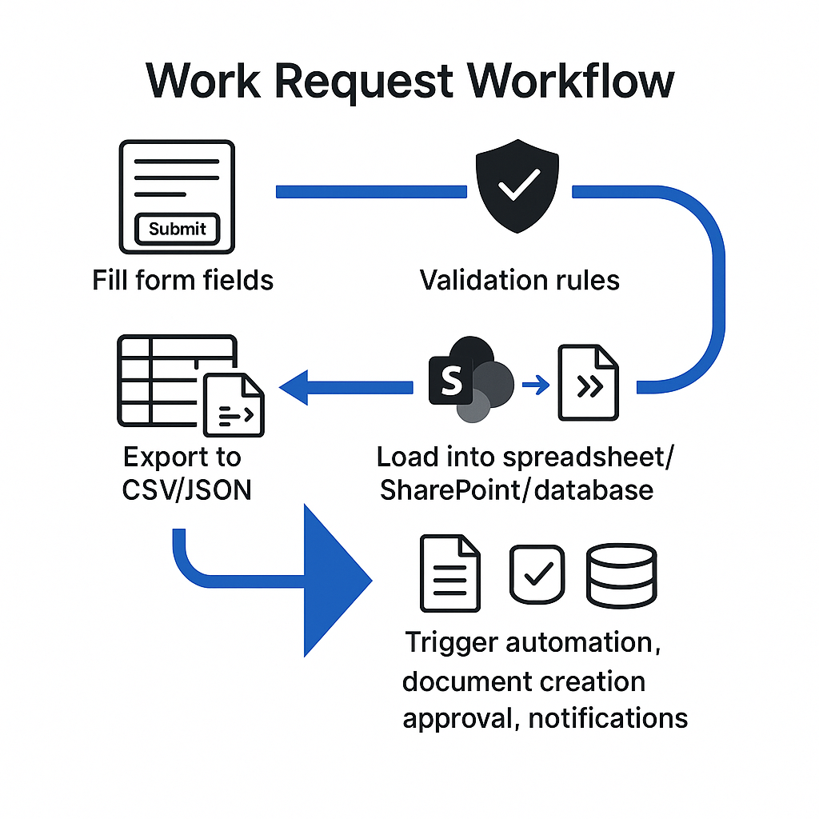
Power Automate
Extract data needed and create a JSON array
Use JSON data to load into HTML form for detailed response
Collect information from Users
Lots of Use cases
Flexible
Send in bulk

Slide 11

Power Automate Video
Webhooks + HTML Form + Json + Datastore (SharePoint lists, Excel, Power BI, etc)

Slide 12

Quick Win Opportunities
Rapid design and deployment
Request for information
Document creation
Notifications
Activity-based costing collections implementation
Empowering reviews

Slide 13
NHS Finance Use Cases
Use Case | Challenge | Solution | Outcome
Budget Management & Resource Allocation | Collecting information | Integrated into lists | Reduced manual effort processing data
User Access Review | Fragmented email approval system, complex process to obtain and filter user data for review | Form approval with workflow to investigate amendments and removal requests | 50/60% time savings through bulk processing and more action based rather than gathering information
One-to-many to budget manager cost centre review | Complex request, never really reviewed unless change in org structure creating weakness in approval rights in system | Simplify outputs | Improved review and streamlined process

Slide 14
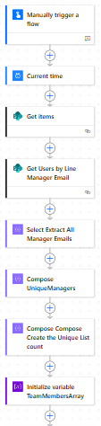

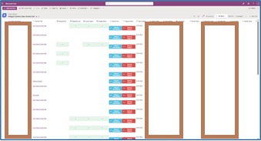
Power Automate Flow Send Example

Slide 15
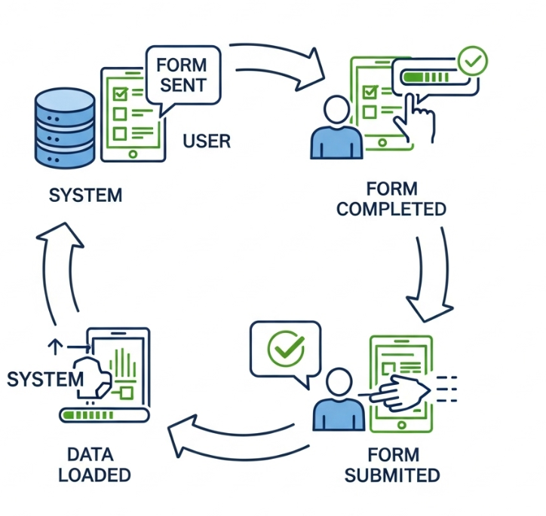

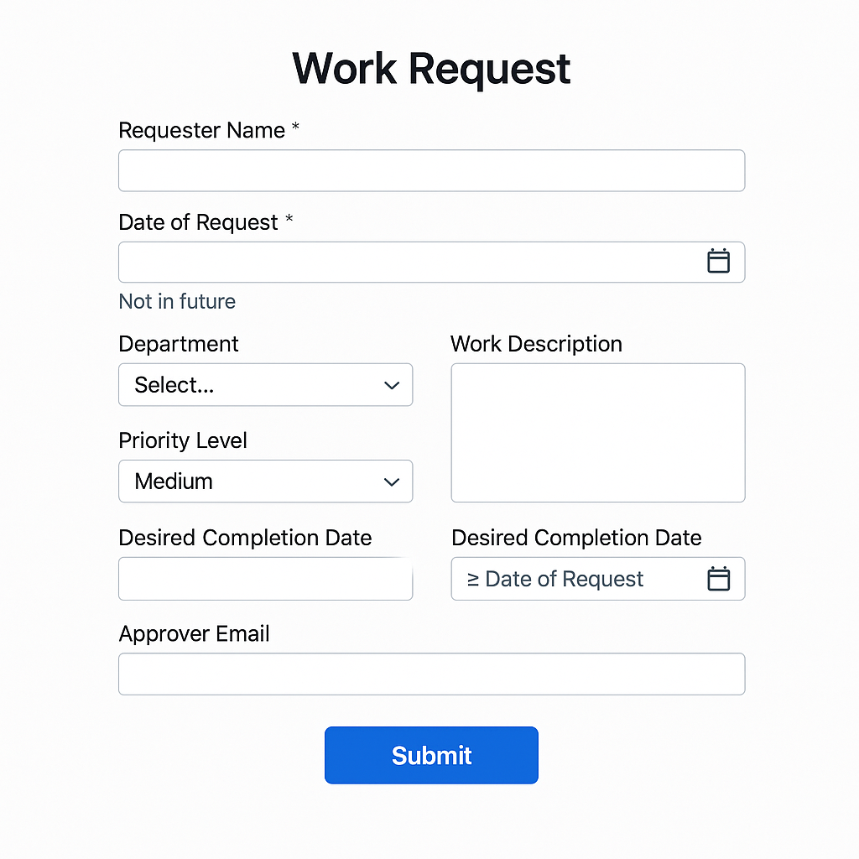
HTML Form Document
Design user friendly forms
Use LLMs to support the coding and HTML design

Slide 16
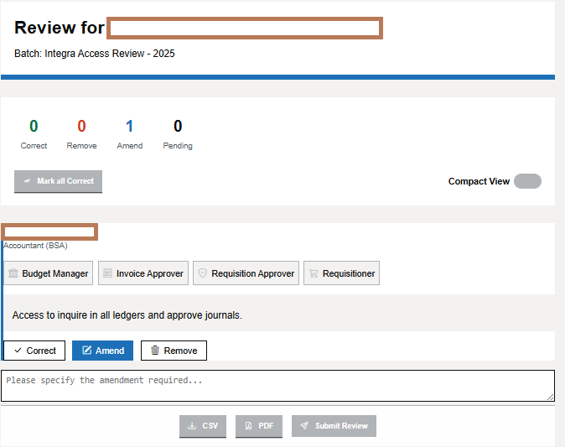
HTML Form Document

Slide 17
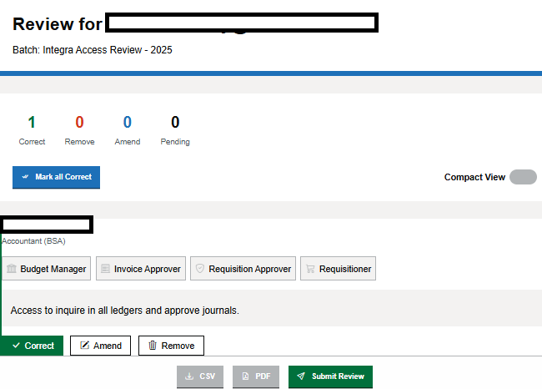
HTML Form Document

Slide 18
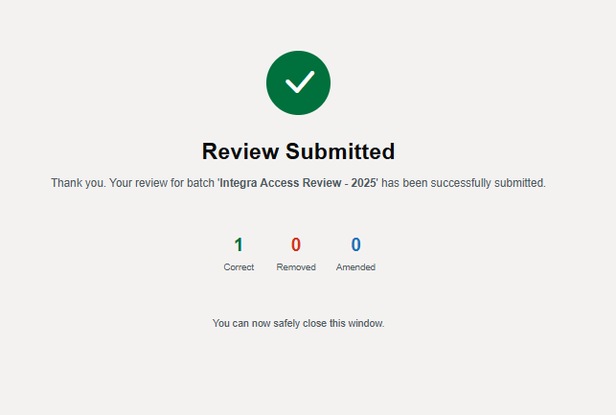
HTML Form Document

Slide 19
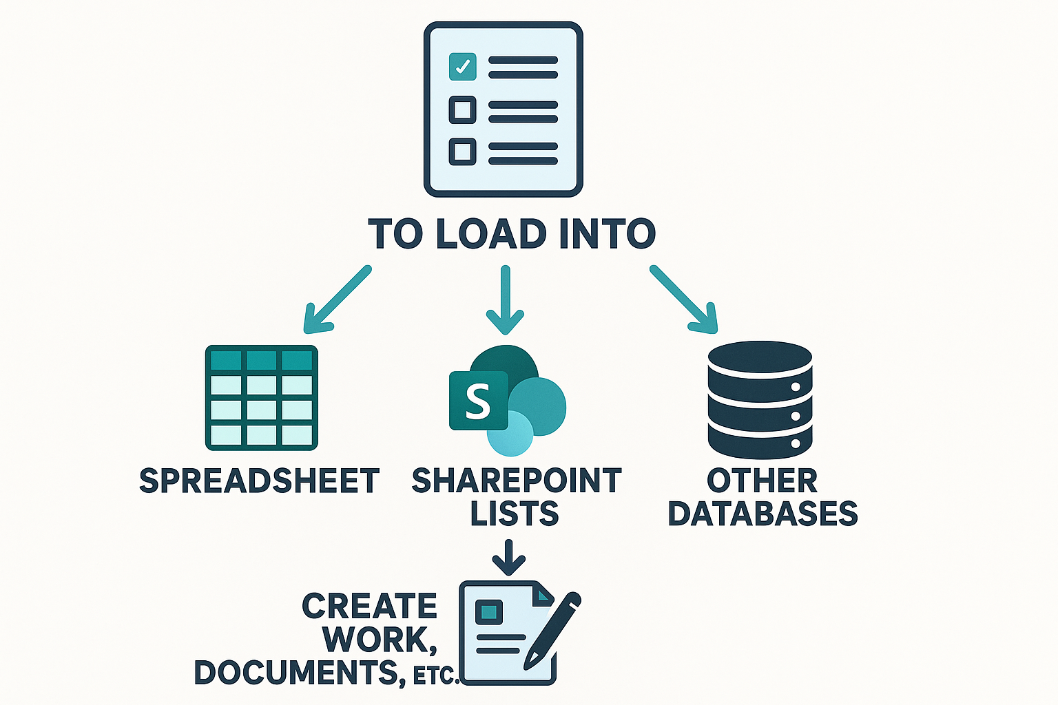
Power Automate
Use the response from the form to load into
Spreadsheet
SharePoint Lists
Other Databases
Create work, documents, etc.

Slide 20
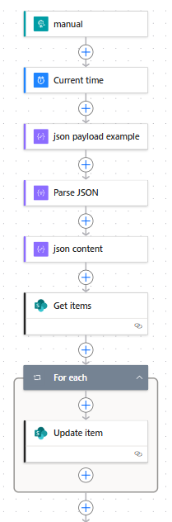
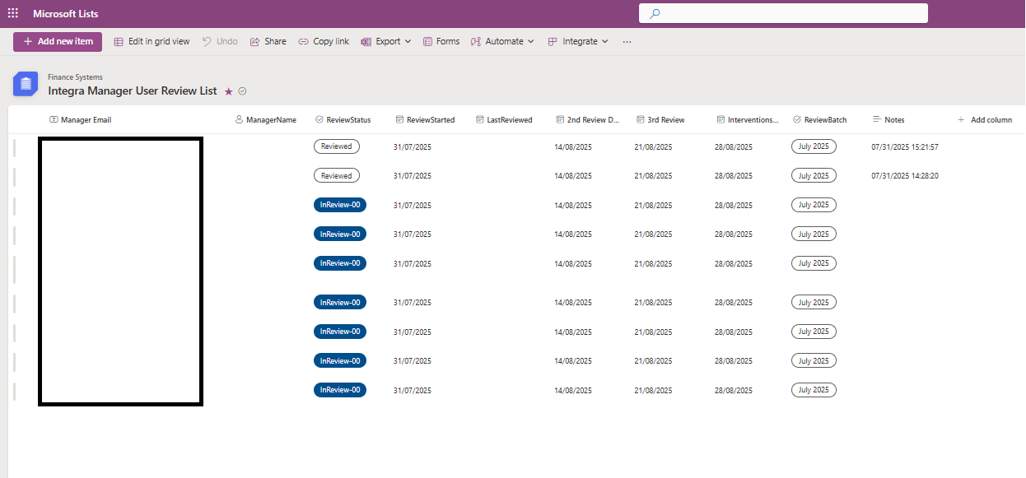
Power Automate Flow Return Example

Slide 21
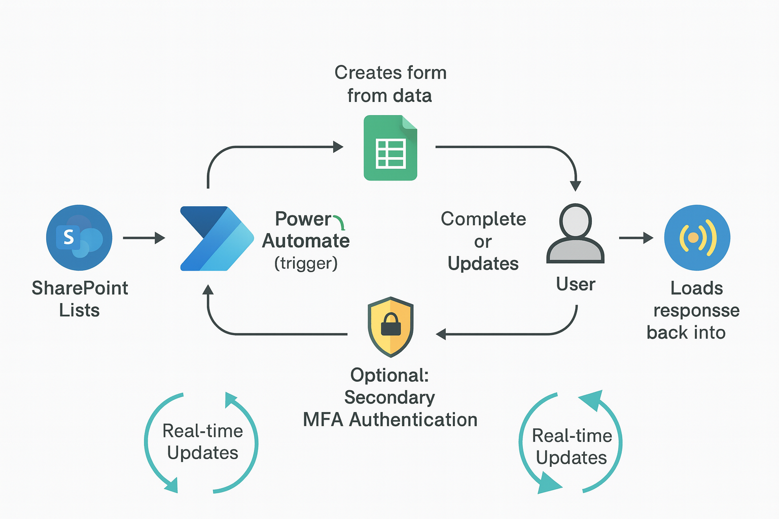
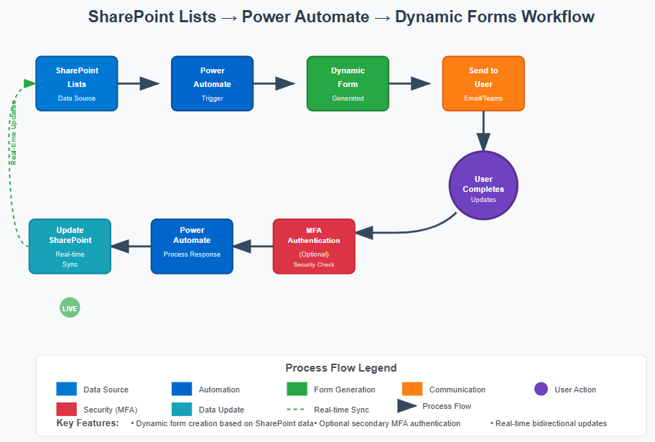
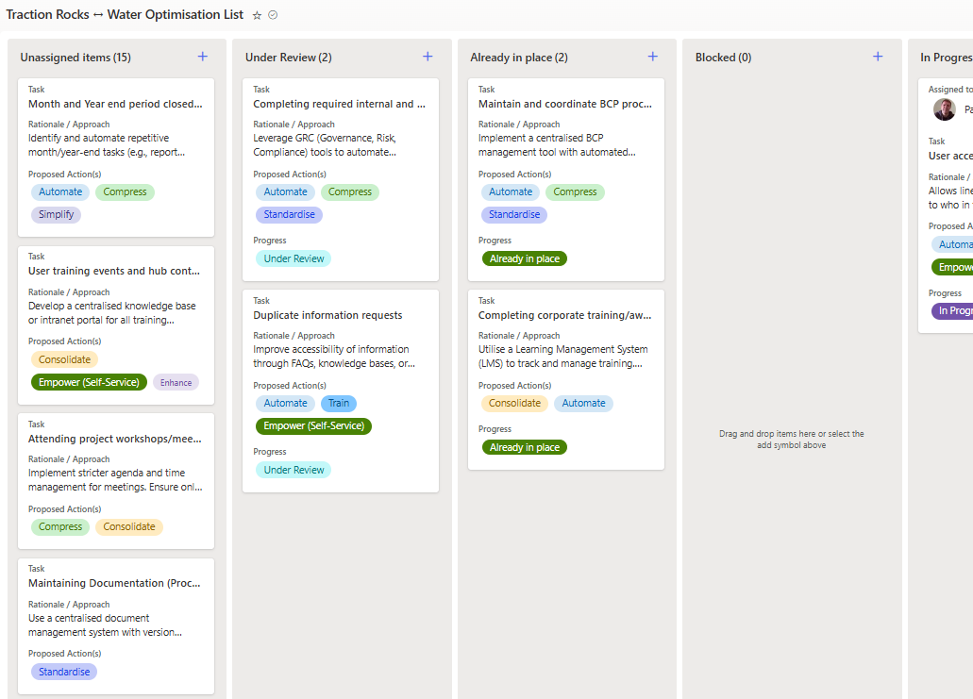
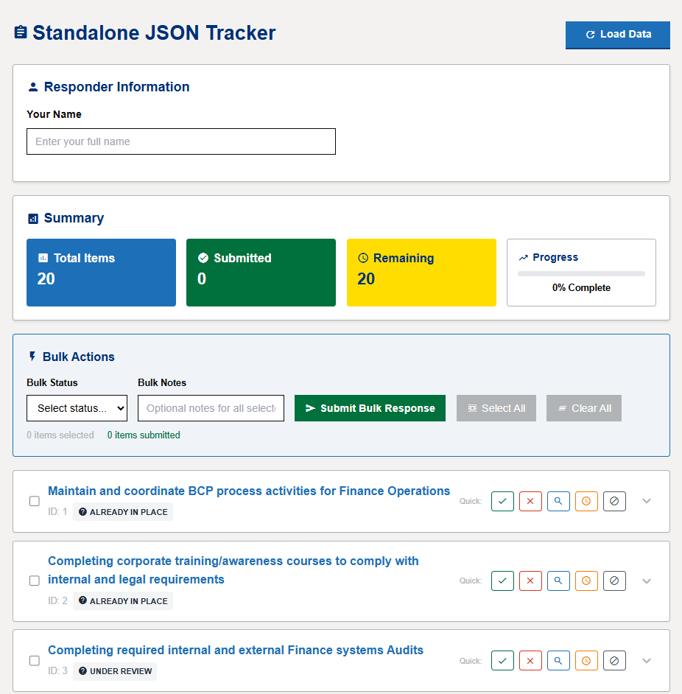

Dynamic updates
Using a webhook request to obtain the data to process into a form to then submit updates back to the source
Load Data
Back
SharePoint List
User Update
Notes:
<svg viewBox="0 0 1000 700" xmlns="http://www.w3.org/2000/svg">
<!-- Background -->
<rect width="1000" height="700" fill="#f8f9fa"/>
<!-- Title -->
<text x="500" y="30" font-family="Arial, sans-serif" font-size="24" font-weight="bold" text-anchor="middle" fill="#2c3e50">SharePoint Lists → Power Automate → Dynamic Forms Workflow</text>
<!-- SharePoint Lists -->
<rect x="50" y="80" width="120" height="80" rx="8" fill="#0078d4" stroke="#005a9e" stroke-width="2"/>
<text x="110" y="105" font-family="Arial, sans-serif" font-size="12" font-weight="bold" text-anchor="middle" fill="white">SharePoint</text>
<text x="110" y="125" font-family="Arial, sans-serif" font-size="12" font-weight="bold" text-anchor="middle" fill="white">Lists</text>
<text x="110" y="145" font-family="Arial, sans-serif" font-size="10" text-anchor="middle" fill="#cce7ff">Data Source</text>
<!-- Arrow 1 -->
<path d="M 170 120 L 230 120" stroke="#34495e" stroke-width="3" fill="none" marker-end="url(#arrowhead)"/>
<!-- Power Automate 1 -->
<rect x="250" y="80" width="120" height="80" rx="8" fill="#0066cc" stroke="#004d99" stroke-width="2"/>
<text x="310" y="105" font-family="Arial, sans-serif" font-size="12" font-weight="bold" text-anchor="middle" fill="white">Power</text>
<text x="310" y="125" font-family="Arial, sans-serif" font-size="12" font-weight="bold" text-anchor="middle" fill="white">Automate</text>
<text x="310" y="145" font-family="Arial, sans-serif" font-size="10" text-anchor="middle" fill="#cce7ff">Trigger</text>
<!-- Arrow 2 -->
<path d="M 370 120 L 430 120" stroke="#34495e" stroke-width="3" fill="none" marker-end="url(#arrowhead)"/>
<!-- Form Creation -->
<rect x="450" y="80" width="120" height="80" rx="8" fill="#28a745" stroke="#1e7e34" stroke-width="2"/>
<text x="510" y="105" font-family="Arial, sans-serif" font-size="12" font-weight="bold" text-anchor="middle" fill="white">Dynamic</text>
<text x="510" y="125" font-family="Arial, sans-serif" font-size="12" font-weight="bold" text-anchor="middle" fill="white">Form</text>
<text x="510" y="145" font-family="Arial, sans-serif" font-size="10" text-anchor="middle" fill="#d4edda">Generated</text>
<!-- Arrow 3 -->
<path d="M 570 120 L 630 120" stroke="#34495e" stroke-width="3" fill="none" marker-end="url(#arrowhead)"/>
<!-- Send to User -->
<rect x="650" y="80" width="120" height="80" rx="8" fill="#fd7e14" stroke="#e55a00" stroke-width="2"/>
<text x="710" y="105" font-family="Arial, sans-serif" font-size="12" font-weight="bold" text-anchor="middle" fill="white">Send to</text>
<text x="710" y="125" font-family="Arial, sans-serif" font-size="12" font-weight="bold" text-anchor="middle" fill="white">User</text>
<text x="710" y="145" font-family="Arial, sans-serif" font-size="10" text-anchor="middle" fill="#fff3cd">Email/Teams</text>
<!-- Arrow down -->
<path d="M 710 160 L 710 220" stroke="#34495e" stroke-width="3" fill="none" marker-end="url(#arrowhead)"/>
<!-- User Interaction -->
<circle cx="710" cy="270" r="50" fill="#6f42c1" stroke="#5a2d8c" stroke-width="3"/>
<text x="710" y="265" font-family="Arial, sans-serif" font-size="12" font-weight="bold" text-anchor="middle" fill="white">User</text>
<text x="710" y="280" font-family="Arial, sans-serif" font-size="12" font-weight="bold" text-anchor="middle" fill="white">Completes</text>
<text x="710" y="295" font-family="Arial, sans-serif" font-size="10" text-anchor="middle" fill="#e2d3f7">Updates</text>
<!-- Arrow down and left -->
<path d="M 670 310 Q 640 340 580 340 L 520 340" stroke="#34495e" stroke-width="3" fill="none" marker-end="url(#arrowhead)"/>
<!-- MFA Check -->
<rect x="400" y="320" width="120" height="80" rx="8" fill="#dc3545" stroke="#c82333" stroke-width="2"/>
<text x="460" y="340" font-family="Arial, sans-serif" font-size="11" font-weight="bold" text-anchor="middle" fill="white">MFA</text>
<text x="460" y="355" font-family="Arial, sans-serif" font-size="11" font-weight="bold" text-anchor="middle" fill="white">Authentication</text>
<text x="460" y="375" font-family="Arial, sans-serif" font-size="10" text-anchor="middle" fill="#f8d7da">(Optional)</text>
<text x="460" y="390" font-family="Arial, sans-serif" font-size="9" text-anchor="middle" fill="#f8d7da">Security Check</text>
<!-- Arrow left -->
<path d="M 400 360 L 340 360" stroke="#34495e" stroke-width="3" fill="none" marker-end="url(#arrowhead)"/>
<!-- Power Automate 2 -->
<rect x="220" y="320" width="120" height="80" rx="8" fill="#0066cc" stroke="#004d99" stroke-width="2"/>
<text x="280" y="340" font-family="Arial, sans-serif" font-size="12" font-weight="bold" text-anchor="middle" fill="white">Power</text>
<text x="280" y="355" font-family="Arial, sans-serif" font-size="12" font-weight="bold" text-anchor="middle" fill="white">Automate</text>
<text x="280" y="375" font-family="Arial, sans-serif" font-size="10" text-anchor="middle" fill="#cce7ff">Process Response</text>
<!-- Arrow left -->
<path d="M 220 360 L 160 360" stroke="#34495e" stroke-width="3" fill="none" marker-end="url(#arrowhead)"/>
<!-- Update SharePoint -->
<rect x="40" y="320" width="120" height="80" rx="8" fill="#17a2b8" stroke="#138496" stroke-width="2"/>
<text x="100" y="340" font-family="Arial, sans-serif" font-size="12" font-weight="bold" text-anchor="middle" fill="white">Update</text>
<text x="100" y="355" font-family="Arial, sans-serif" font-size="12" font-weight="bold" text-anchor="middle" fill="white">SharePoint</text>
<text x="100" y="375" font-family="Arial, sans-serif" font-size="10" text-anchor="middle" fill="#d1ecf1">Real-time</text>
<text x="100" y="390" font-family="Arial, sans-serif" font-size="10" text-anchor="middle" fill="#d1ecf1">Sync</text>
<!-- Real-time indicator -->
<circle cx="100" cy="450" r="15" fill="#28a745">
<animate attributeName="opacity" values="1;0.3;1" dur="2s" repeatCount="indefinite"/>
</circle>
<text x="100" y="455" font-family="Arial, sans-serif" font-size="10" font-weight="bold" text-anchor="middle" fill="white">LIVE</text>
<!-- Arrow back up (feedback loop) -->
<path d="M 40 360 Q 10 360 10 200 Q 10 120 50 120" stroke="#28a745" stroke-width="2" fill="none" marker-end="url(#arrowheadGreen)" stroke-dasharray="5,5"/>
<!-- Real-time updates label -->
<text x="20" y="240" font-family="Arial, sans-serif" font-size="11" font-weight="bold" fill="#28a745" transform="rotate(-90 20 240)">Real-time Updates</text>
<!-- Legend -->
<rect x="50" y="520" width="900" height="120" rx="8" fill="white" stroke="#dee2e6" stroke-width="1"/>
<text x="500" y="545" font-family="Arial, sans-serif" font-size="16" font-weight="bold" text-anchor="middle" fill="#495057">Process Flow Legend</text>
<!-- Legend items -->
<rect x="80" y="560" width="30" height="20" fill="#0078d4"/>
<text x="120" y="575" font-family="Arial, sans-serif" font-size="12" fill="#495057">Data Source</text>
<rect x="250" y="560" width="30" height="20" fill="#0066cc"/>
<text x="290" y="575" font-family="Arial, sans-serif" font-size="12" fill="#495057">Automation</text>
<rect x="420" y="560" width="30" height="20" fill="#28a745"/>
<text x="460" y="575" font-family="Arial, sans-serif" font-size="12" fill="#495057">Form Generation</text>
<rect x="590" y="560" width="30" height="20" fill="#fd7e14"/>
<text x="630" y="575" font-family="Arial, sans-serif" font-size="12" fill="#495057">Communication</text>
<circle cx="795" cy="570" r="10" fill="#6f42c1"/>
<text x="815" y="575" font-family="Arial, sans-serif" font-size="12" fill="#495057">User Action</text>
<rect x="80" y="590" width="30" height="20" fill="#dc3545"/>
<text x="120" y="605" font-family="Arial, sans-serif" font-size="12" fill="#495057">Security (MFA)</text>
<rect x="250" y="590" width="30" height="20" fill="#17a2b8"/>
<text x="290" y="605" font-family="Arial, sans-serif" font-size="12" fill="#495057">Data Update</text>
<line x1="420" y1="600" x2="450" y2="600" stroke="#28a745" stroke-width="2" stroke-dasharray="5,5"/>
<text x="460" y="605" font-family="Arial, sans-serif" font-size="12" fill="#495057">Real-time Sync</text>
<path d="M 590 595 L 610 595" stroke="#34495e" stroke-width="3" marker-end="url(#arrowhead)"/>
<text x="620" y="600" font-family="Arial, sans-serif" font-size="12" fill="#495057">Process Flow</text>
<!-- Key Features -->
<text x="80" y="625" font-family="Arial, sans-serif" font-size="14" font-weight="bold" fill="#495057">Key Features:</text>
<text x="190" y="625" font-family="Arial, sans-serif" font-size="12" fill="#495057">• Dynamic form creation based on SharePoint data</text>
<text x="460" y="625" font-family="Arial, sans-serif" font-size="12" fill="#495057">• Optional secondary MFA authentication</text>
<text x="720" y="625" font-family="Arial, sans-serif" font-size="12" fill="#495057">• Real-time bidirectional updates</text>
<!-- Arrow markers -->
<defs>
<marker id="arrowhead" markerWidth="10" markerHeight="7" refX="9" refY="3.5" orient="auto">
<polygon points="0 0, 10 3.5, 0 7" fill="#34495e"/>
</marker>
<marker id="arrowheadGreen" markerWidth="10" markerHeight="7" refX="9" refY="3.5" orient="auto">
<polygon points="0 0, 10 3.5, 0 7" fill="#28a745"/>
</marker>
</defs>
</svg>

Slide 22
Document the ‘as is’
Without understanding the process you are not able to understand the opportunities.
Look to address current workaround that impact source data and introduce human interventions – this could often be just updating a report to display date in a different way or building controls on how you receive data.
Remember:
You need to involve the people in the process who produce the outputs
Be prepared to work differently
Look to previous solutions to problems and linking and evolving processes along the way can optimise and speed up solution design and build on what's there than start a new each time.
Don’t disembark an initiative so quickly….
Automation often fits the 80/90% of use cases so consider if this complexity build into the ‘to be’ process if a ‘human in the loop’ approach could manage exceptions rather than rule out the whole process and what improvements can be made

Slide 23
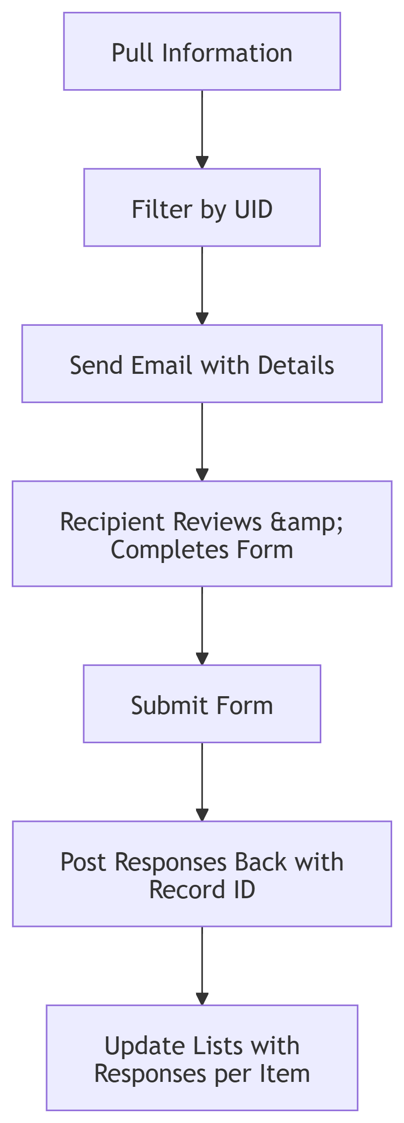
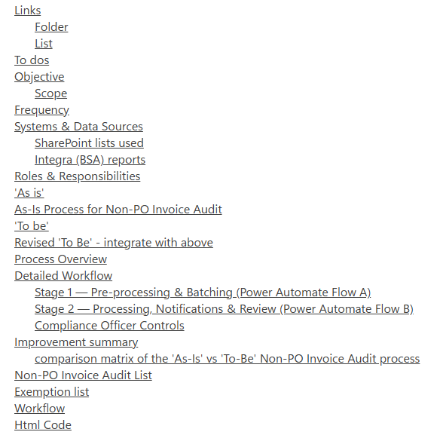
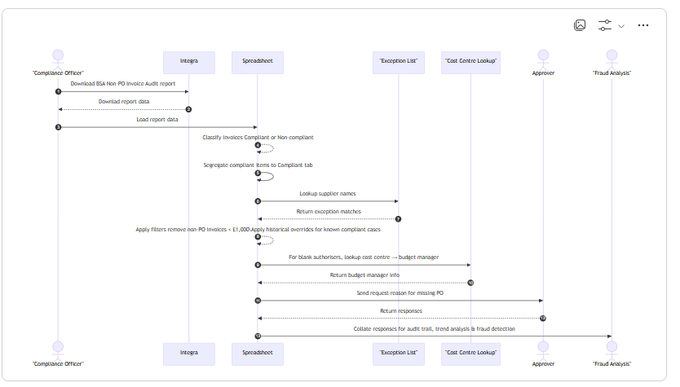
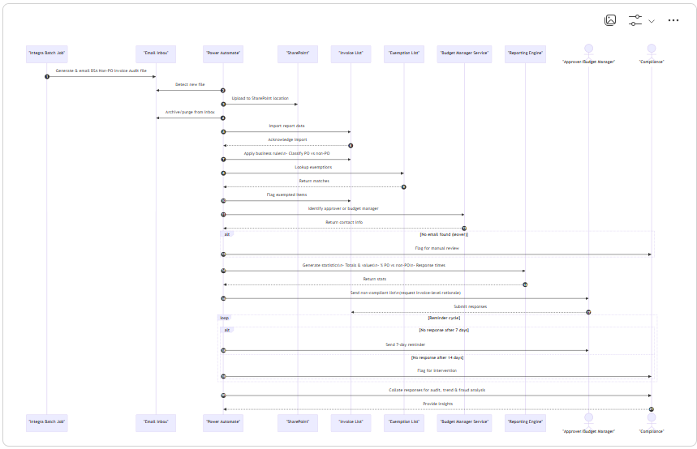
Create a ‘Product Requirement Document’
A Product requirement document (PRD) is a light-touch requirements document to generate the outcome.
Use an LLM or other tools.
Always consider the data and anonymise any information. Use it as an assistant to your idea and it will enable you to expand. There is no blueprint for this document, but the basics should include the problem, scope, ‘as is’, ‘to be’ and outputs to support the new process development (and links to supporting documents).
Use tools like mermaid to document the processes and maintain/update easier.
‘as is’
Replace manual collection & analysis with automated Workflow
‘to be’

Slide 24
Using LLMs to support
Use the problem statement and ‘as is’ to create an automated flow of suggestions from the LLM
Direct it to what your solutions could be if you have power automate, power bi, or excel. This will help it focus on solutions that will be adaptable to your needs
Utilise LLMS to also ‘transform’ the language to the new language
Example, you have an excel formula that works, just ask the LLM to convert to DAX for Power BI, or even better, provide the ref. detail of the Power BI and it will create the complex copy and paste DAX. The more context the better the support from the LLM.
Use the LLMs to learn and explore the use of other technologies along the way to support the new tools
Learn *SharePoint lists if you used Microsoft Office and have an E3 licenseor space to store ‘flat’ file data which can be linked to various other stored but great for a temp space to automate with and before committing to major datasets ensuring enhanced controls on master datasets and true audit control.
Learn *Power Automate
Learn HTML and use LLMs to generate the code and support the development of inputs. Use it to create a template and reuse this template in future conversations to create consistent outputs. Use tools like Loop to store the code and retrieve when needed.
Learn advance functions in tools to change data and Use an LLM or other tools.
*IT may have to enable this for you in your Apps.

